Slide 1
Innards of Language Translators
Prof. Darrell Long
CSE 13S

Slide 2
What is a Language Translator?
Simply put, a program that maps an input language to an output language.
Roles
Converting high-level source language to machine level target language.
Provide diagnostic messages if the programmer violates specifications of the high-level language program

Slide 3
Who even needs Language Translators?
“John von Neumann, when he first heard about FORTRAN in 1954, was unimpressed and asked ‘Why would you want more than machine language?’ One of von Neumann’s students at Princeton recalled that graduate students were being used to hand assemble programs into binary for their early machine. This student took time out to build an assembler, but when von Neumann found out about it he was very angry, saying that it was a waste of valuable scientific computing instrument to do clerical work.”
—John A.N. Lee, Virginia Polytechnical Institute

Slide 4
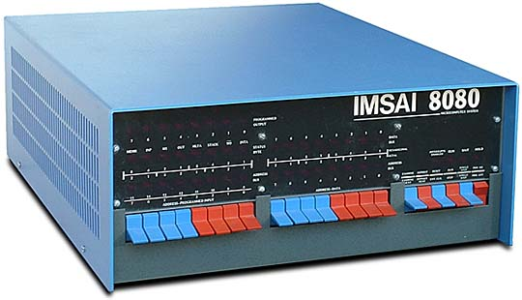
In the good old days
Computers were programming in binary
Or hexidemical
Or Octal
It was hard
You hated assembly language in CSE 12, well, this was harder

Slide 5

The need for Language Translators
Computers are a balanced mix of software and hardware
Hardware functions are controlled by a compatible software
Binary, 0 and 1
Hardware codes are interpreted in binary format
Difficult and cumbersome task for computer programmers to write such codes
Notes:
The following binary code/ SOAP (Symbolic Optimal Assembly Program) does matrix multiplication for a 4x5 matrx with a 5x3 matrix. Mind you that optimal means rearranging instructions on slowly rotating drum memory (not as good as hand assembly)

Slide 6
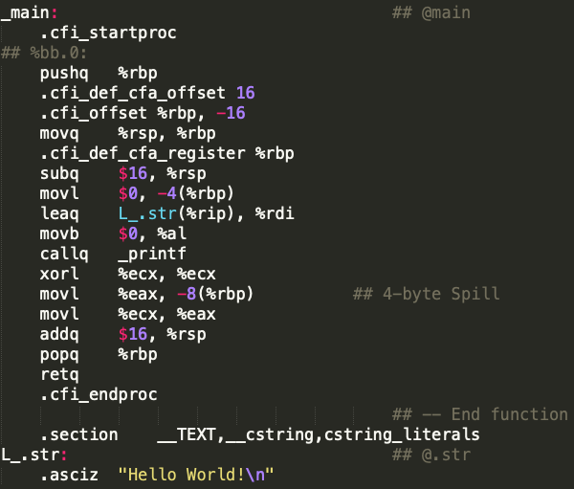
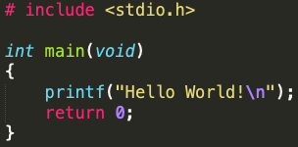
So how do we compile a program?
gcc –S hello.c

Slide 7
Compilation process of a C program
Source Code
hello.c
Pre-processor
The compiling process is a sequence of four phases. The input for each phase is the output of the previous phase.
Pre-processor
Including Macros, and the Macroprocessor
Compiler
Assembler
Linker
hello.i
Compiler
Assembly code
hello.s
Assembler
Libraries
Object code
Linker
hello.o
Executable
hello
Notes:
https://stackoverflow.com/questions/3996651/what-is-compiler-linker-loader // this has a nicely made diagram in text, includes 7 phases of compilation process

Slide 8
1. The Pre-processor (and the macroprocessor)
Source Code
hello.c
Pre-processor
Source code is passed into preprocesser:
Execute preprocessor directives, all beginning with a #
(Ex. #include, #ifndef, #endif, etc.)
Include header files from other libraries
If header guards are used, include IFF the condition has been met
Comments are removed
Macroprocessor will replace each macro instruction with its corresponding definition
To view preprocessed output:
clang –E <FILE>.c
Compiler
Assembly code
hello.s
Assembler
Libraries
Object code
Linker
hello.o
Executable
hello
Notes:
Takes hello.c and generates intermediate file, hello.i

Slide 9
2. The Compiler
Source Code
hello.c
Pre-processor
The compiler converts hello.i from the preprocessor into assembly code in 7 steps:
Lexical Phase
Syntax Phase
Translation Phase
Optimization
Storage Assignment
Code Generation
Assembly Phase
Outputs assembly code into hello.s
hello.i
Compiler
Assembly code
hello.s
Assembler
Libraries
Object code
Linker
hello.o
Executable
hello
Notes:
“Compilers are systems programs that accept people-like languages and translate them into machine language”
7 phases
Lexical Phase
Syntax Phase
Interpretation Phase
Optimization
Storage Assignment
Code Generation
Assembly Phase
Takes hello.i and converts it into assembly code, hello.s
That the compiler spat out assembly code but now we need something/someone to translate/convert that into object file now

Slide 10


Compilers: Lexical phase
Break down the source code from preprocessor into lexemes, generating a sequence of tokens as a unit in the grammar of the programming language
Tokens used to construct a parse tree in the next step of compilation
Examples of tokens include keywords (int), identifiers, operators, and separators ( (), {}, |)
Non-tokens: Comments, Preprocessor Directive, Macros, Whitespace
Throws error if sequence does not match any valid token
Notes:
Systems Programming, page 280-283
PREVIOUS WORK:
There are 3 tasks for the lexical analysis phase
Parse source program into tokens
Build a Symbol table and Identifier table
Take tokens and make appropriate entries into appropriate tables
Symbol Table
Created by lexical analysis to describe all literals from source program
One entry per literal: value, attributes (data type, precision), address of literal at execution time //Should I include this last blip?
Values of variables
Identifier table
Created by lexical analysis to describe identifiers used in source program
Variable names
Build a uniform symbol table
Created by lexical analysis to represent program as string of tokens //Should I include this line or no? @Tim
One uniform symbol per token
Each uniform symbol contains the table the token is a member of and the corresponding index

Slide 11

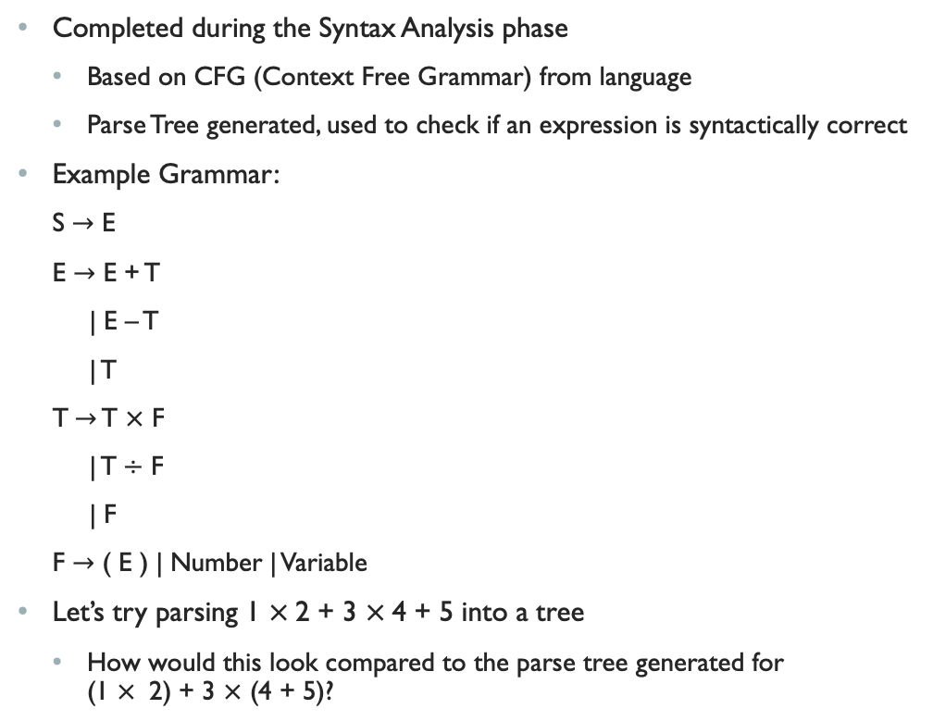

Parse Trees and E-T-F Grammar
E
Completed during the Syntax Analysis phase
Based on CFG (Context Free Grammar) from language
Parse Tree generated, used to check if an expression is syntactically correct
Example Grammar:
S $→$ E
E $→$ E + T
| E – T
| T
T$→$ T $×$ F
| T$÷$ F
| F
F $→\text{( }\text{E}\text{ )}$ | Number | Variable
Let’s try parsing 1 $×$2 + 3 $×$4 + 5 into a tree
How would this look compared to the parse tree generated for (1 $×$ 2) + 3 $×$ (4 + 5)?
E
+
T
E
+
T
F
T
T
$$×$$
F
Num 5
F
T
$$×$$
F
Num 4
F
Num 3
Num 2
Num 1

Slide 12
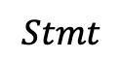
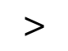
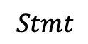
Abstract syntax trees
A representation of tokens generated from statements and expressions in the programming language
Represented as a hierarchical tree-like structure, similar to Concrete Syntax Trees
Used for generating symbol tables and representing constructs and rules in the language
Let’s write an abstract syntax tree for the following code:
if (2 > 1)
printf(“True”);
else
printf(“False”);
if
$$>$$
$$Stmt$$
$$Stmt$$
2
1
printf
“True”
printf
“False”

Slide 13
3. The Assembler
Source Code
hello.c
Pre-processor
Converts assembly language instructions to machine language (binary)
Assemblers can perform conversion in one of two ways:
One pass: Traverse through assembly once. Symbols used before being defined must include an “errata” at the end of the object code, letting the linker know to overwrite the undefined symbol with its respective definition
Two pass: Create a mapping of symbols and their values in first traversal, then replace symbols with their definitions upon second pass translation
Compiler
Assembly code
hello.s
Assembler
Libraries
Object code
Linker
hello.o
Executable
hello
Notes:
Automate the process from assembly language to machine language
Takes hello.s and converts it into object code, hello.o
Responsible for converting assembly language to machine language
Like a compiler, as they both take a in some sort of language and produce executable code, but assembly are a bit more simplistic as they produce machine language
Assembler can do
One pass: go through source code only once, but symbols that are used before being defined must include an “errata” at end of program to go back which tells
Two-pass: make two passes over the program because symbols can appear before they are defined

Slide 14
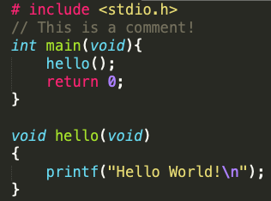
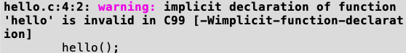
Forward referencing in assembly
Attempting to compile the code below results in the following warning:
One Pass Forward Referencing:
Cannot resolve forward references, therefore, back-patching used to fill in spots of unknown address
Two Pass Forward Referencing:
Symbol Table, Op-Code Table and Label Table maintained
Second pass through of assembler translates to machine language, replacing names of labels to addresses found in their respective tables
Loader required to allocate memory for object code
How can we fix this error?
Notes:
https://www.cs.auckland.ac.nz/references/unix/digital/AQTLTBTE/DOCU_024.HTM
Note that One pass and Two pass are two algorithms, however there are more including chaining which sort of is like linking together the definitions, so you don’t have to do it in two passes
The problem mainly lies in the fact that you cannot see in the future

Slide 15
4. The LINKER
Source Code
hello.c
Pre-processor
Links hello.o along with any other object files and libraries
Ensure that all dependencies are properly resolved
Linker error thrown if definitions to something cannot be referenced
Merges everything into one executable file
In this case, hello
Compiler
Assembly code
hello.s
Assembler
Libraries
Object code
Linker
hello.o
Executable
hello
Notes:
Takes our object code, hello.o, links with libraries and merges it into one file, the executable

Slide 16
Loaders
Lays in the operating system.
Ensures program and necessary libraries are placed in RAM to prepare them for execution.
The loader has 4 basic functions:
Allocation – allocate space in memory for program
Linking – resolve symbolic references between programs
Relocation – fix all dependent locations and point them to the newly allocated space
Loading – place machine code and data directly into the processor
RAM

Slide 17
Memory
stack
1
Memory layout of an executable can be seen in the figure on the right:
Stack for local variables, return addresses, arguments and return values
Heap for dynamic memory allocation
Uninitialized data, also called “bss” segment, contains declared global and static variables, all initialized to 0 by exec
Initialized data holds global, static, constant, and extern variables that are initialized beforehand
Text segment contains executable instructions
heap
2
uninitialized data (bss)
3
initialized data
4
text
5
Notes:
Image Credit: Rishabh Tripathi
https://www.hackerearth.com/practice/notes/memory-layout-of-c-program/

Slide 18
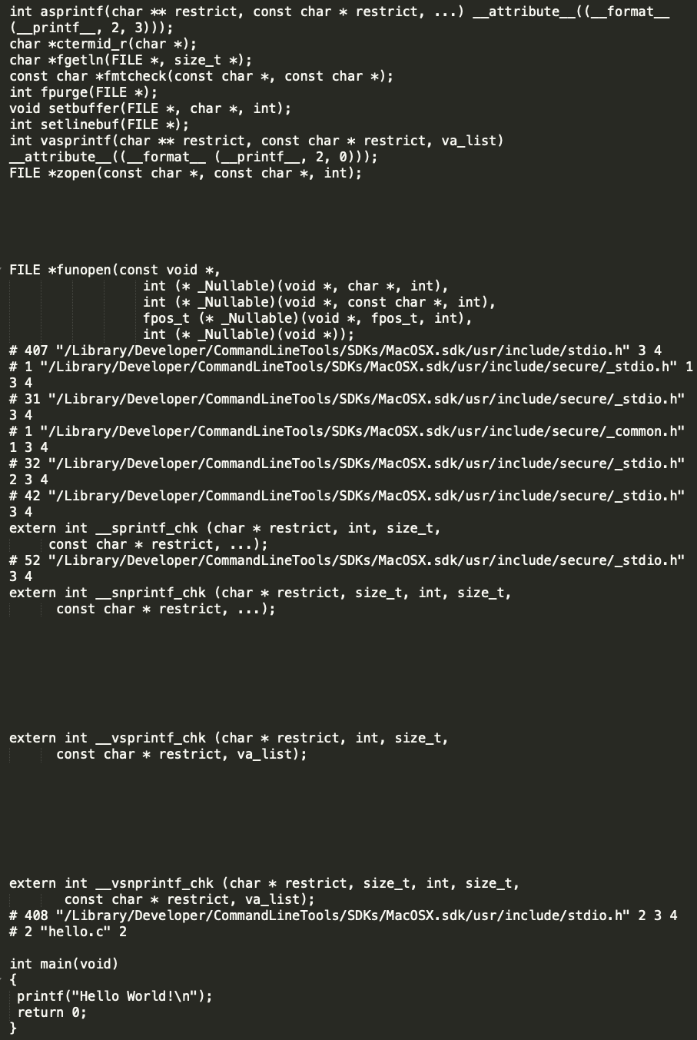
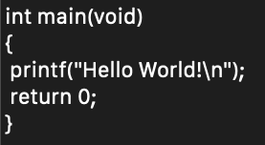
Preprocessor output
Notice how
“//This is a comment!”
has been stripped from the code by the preprocessor
Notes:
Need to fix black box to follow coding style

Slide 19
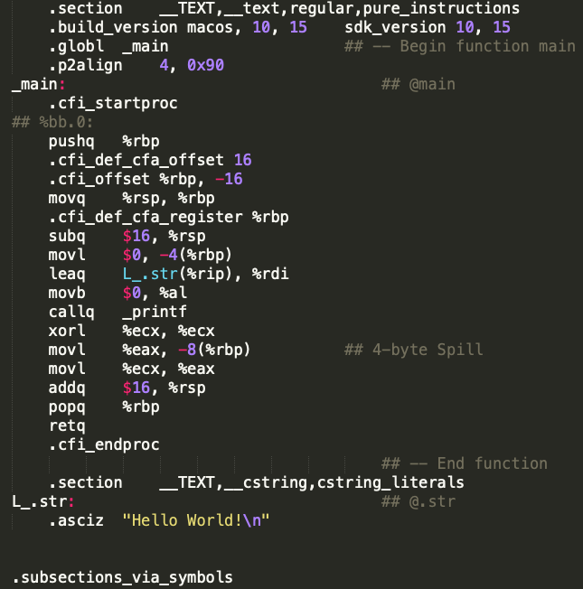
Compiler output

Slide 20
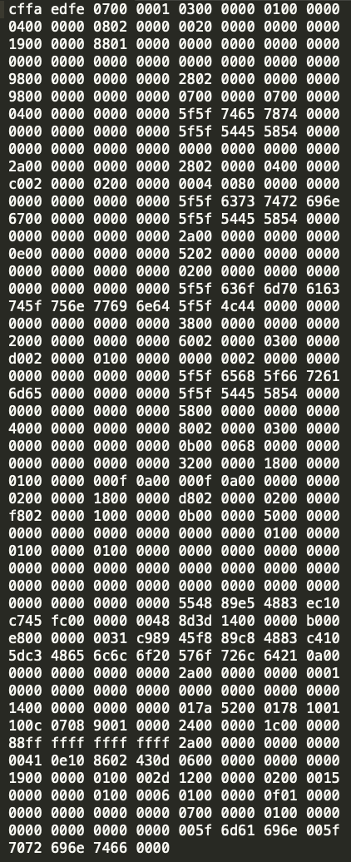
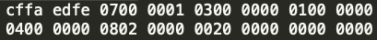
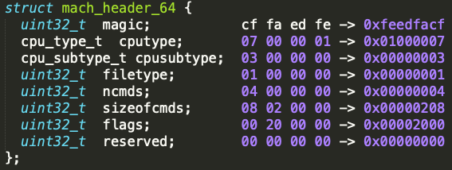
Object file output
Mach-O Object File Header
Hex for Hello World!
Notes:
Wikipedia on Mach-O
Mach-O, short for Mach object file format, is a file format for executables, object code, shared libraries, dynamically-loaded code, and core dumps. A replacement for the a.out format, Mach-O offers more extensibility and faster access to information in the symbol table.
Mach-O is used by most systems based on the Mach kernel. NeXTSTEP, OS X, and iOS are examples of systems that have used this format for native executables, libraries and object code.

Slide 21
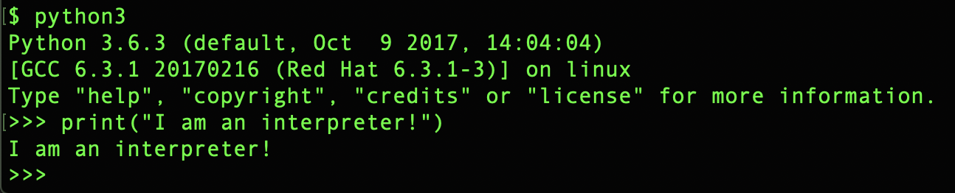
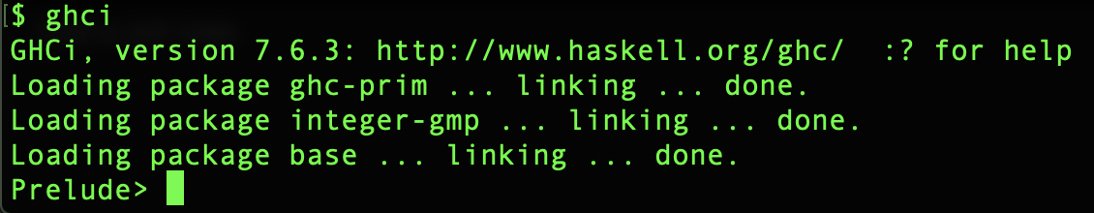
Compilers vs interpreters
Compiler
A translator that takes a high-level programming language, goes through a sequence of translations and outputs an executable
Translates entire program/code at once
Interpreter
A program that directly executes code without needing to compile (Python interpreter, ghci (Haskell))
Translates program one line at a time
Which is faster, the compiler or an interpreter?
Notes:
Added question asking which is faster. Darrell talked/asked/answered this in class and seemed like a good question to get students thinking and putting it together.

Slide 22
GCC vs CC vs Clang
gcc
GNU C Compiler
Default on Linux
cc
Unix/Linux environment variable that points to the default compiler
clang
Default on Mac and FreeBSD
cc
gcc
clang

Slide 23
Coming back to Make
The "make" utility automates the mundane aspects of building executables from source code.
"make" uses a special file called a Makefile, which contains rules on how to build the executables.
Notes:
More on Make and Makefiles in the next lecture

Slide 24
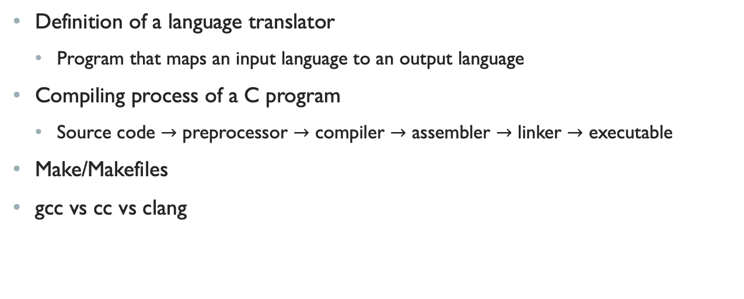
Summary
Definition of a language translator
Program that maps an input language to an output language
Compiling process of a C program
Source code $→$ preprocessor $→$ compiler $→$ assembler $→$ linker $→$ executable
Make/Makefiles
gcc vs cc vs clang
Notes:
Pre processor -> compiler -> assembler -> linker
note that object files and other libraries are included at the linker level

